Slide 1

Migrating to the Next Generation of CM/ECF (NextGen)
by the Los Angeles County Treasurer and tax collector
In Collaboration with the California association of County Treasurers and Tax collectors
October 2021

Slide 2

What is NextGen?
Benefits of NexGen for the CM/ECF Filer
Simplifies electronic filing.
Single Central Sign-On account.
NextGen

Slide 3
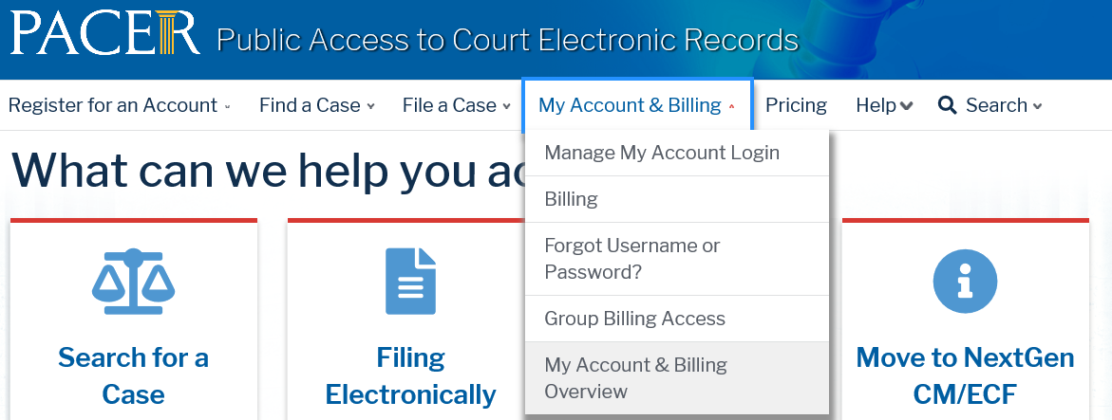

Steps to Successfully Transition to NextGen
Go to www.pacer.gov
  My Account and Billing
  Manage My Account Login.
If account type is listed as Legacy PACER Account
    Upgrade

Slide 4
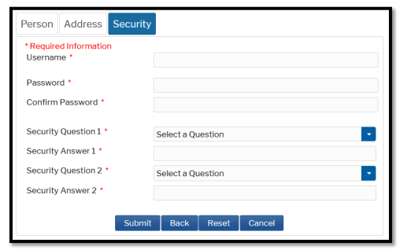
Steps to Successfully Transition to NextGen
Select Upgrade link
Complete the upgrade by verifying your personal information:
Person, Address, and Security
Create new username, password, and security questions.
NOTE:
Old PACER username and password

Slide 5
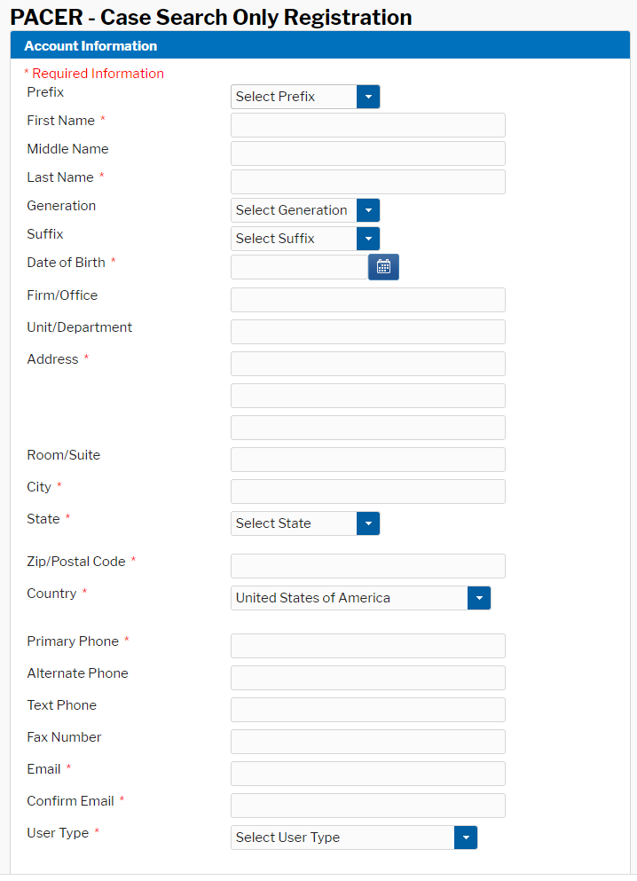

Creating a PACER Account
Go to: https://pacer.uscourts.gov/register-account/pacer-case-search-only
Click:
You will be redirected to the registration form.

Slide 6
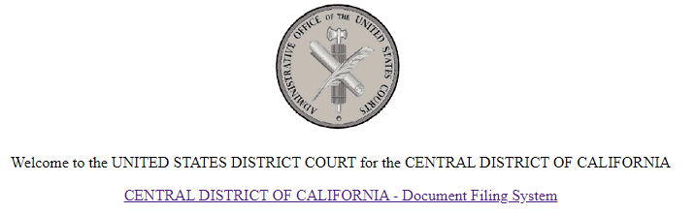
Steps to Successfully Transition to NextGen
Step 2: Link Your CM/ECF Filing Account to Your PACER Account
Go to the NextGen CM/ECF website of the court in which you are registered to e-file. You can look up the court’s website using the Court CM/ECF Lookup.
Click the CM/ECF Document Filing System link. Use your upgraded PACER account credentials to log in.

Slide 7

Steps to Successfully Transition to NextGen
Click the Utilities menu.
Click Link a CM/ECF account to my PACER account.
If you do not see this option:
NextGen Release 1.1 Menu Items
Link a CM/ECF account to my PACER account

Slide 8
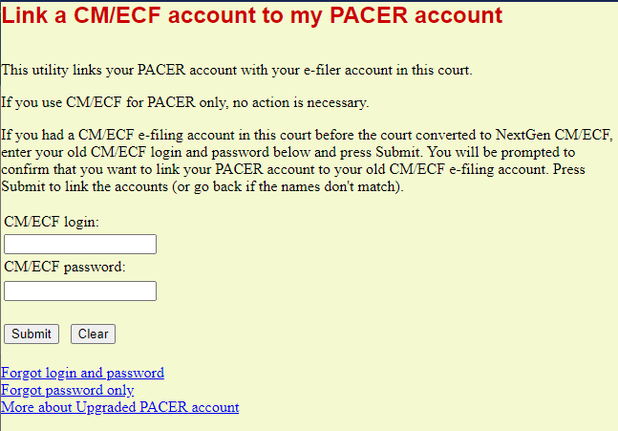
Steps to Successfully Transition to NextGen
Enter your CM/ECF login and password.
Confirm the CM/ECF account being linked to the PACER account.
If successful, you will be sent to the welcome screen for that court.
To obtain your CM/ECF username or reset your password, contact the court.

Slide 9



Thank you for watching!
The CACTTC Bankruptcy Committee presented this video as a part of a training series to facilitate training for staff who monitor and manage taxpayer bankruptcy filings. This is not legal advice, nor is it intended to replace legal counsel.

